Slide 1
Hadoop MapReduce
How to Survive Out-of-Memory Errors
The International Summer Undergraduate Research Fellowship
Member: Yoonseung Choi
Soyeong Park
Faculty Mentor: Prof. Harry Xu Student Mentor: Khanh Nguyen
Notes:
Anteater is so cute

Slide 2
Outline
Introduction
What is MapReduce?
How does MapReduce work?
Limitations of MapReduce
What is our goals?
Operation test
Conclusion

Slide 3
“There was 5 exabytes of information created between the dawn of civilization through 2003,
But that much information is now created
every 2 days, and the pace is increasing...”
- Eric Schmidt, Google CEO
Notes:
Before the speech
spoke at the Techonomy conference(10’) in Lake Tahoe
http://readwrite.com/2010/08/04/google_ceo_schmidt_people_arent_ready_for_the_tech

Slide 4
Data scientists want
to analyze these
large data sets
How can we handle that?
Distribute processing
But single machines
have
limitations
in processing
these data sets
Do we need to
understand
the details of
parallelization,
fault tolerance,
data distribution
and load balancing?
parallelization
fault tolerance
data distribution
load balancing
Furthermore, data sets
are now growing very rapidly
The answer is ‘no’

Slide 5

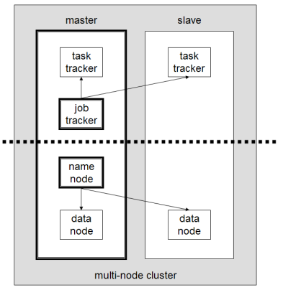
MapReduce is a programming model for processing and generating large data sets
Many real world tasks are expressible in this model
MapReduce Layer
HDFS Layer
The model is easy to use, even for programmers without experience with parallel and distributed systems
* https://en.wikipedia.org/wiki/Apache_Hadoop
[1] Jeffrey Dean and Sanjay Ghemawat. (2004). “MapReduce: Simplified Data Processing on Large Clusters”.

Slide 6
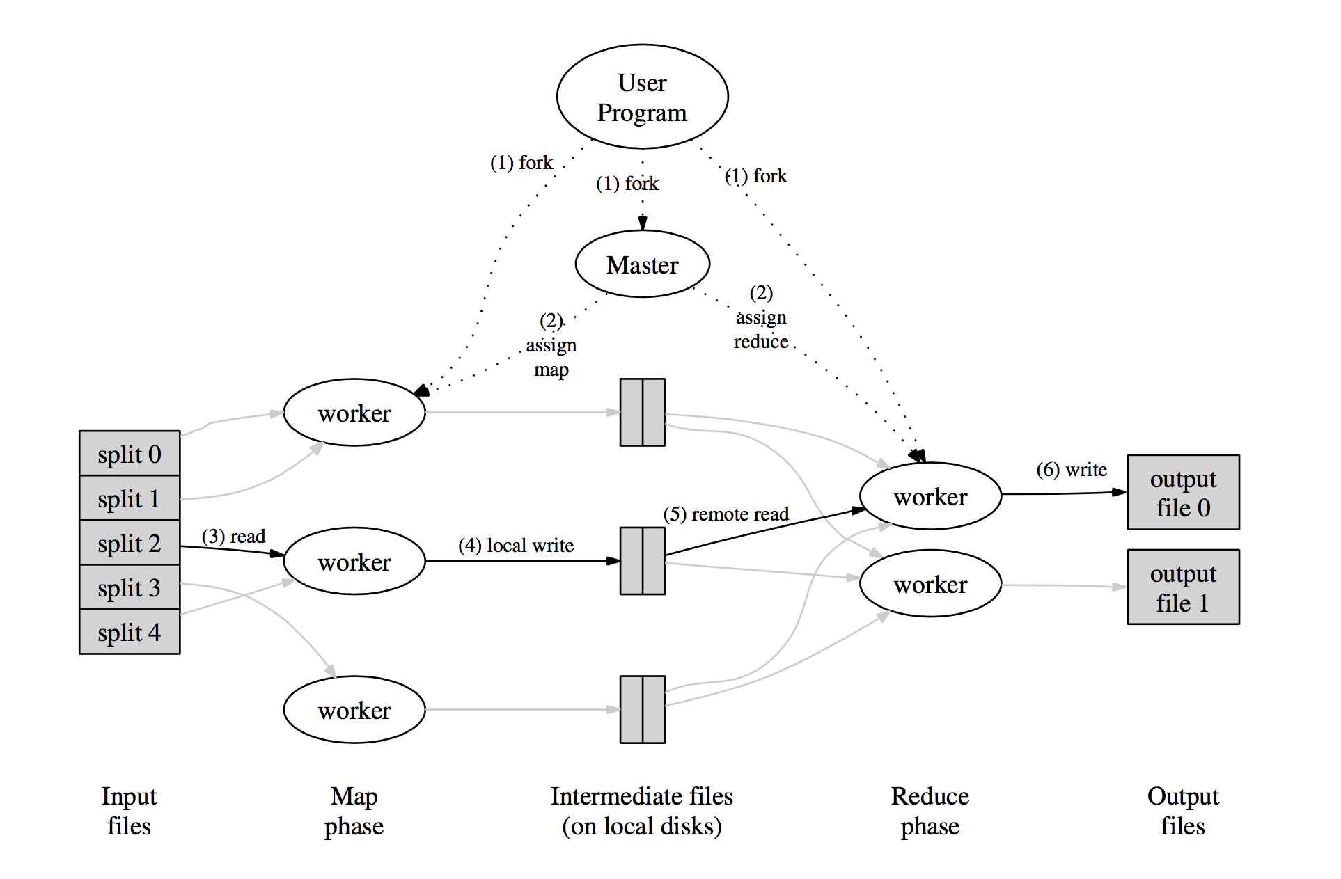
What is MapReduce?
Mapper takes an input
and produces a set
of intermediate
key/value pairs
Reducer merges together
these intermediate values
associated with the same
intermediate key
[1] Jeffrey Dean and Sanjay Ghemawat. (2004). “MapReduce: Simplified Data Processing on Large Clusters”. p.12
Notes:
[1, p.12] – map > emit
* ADD AN ANIMATION

Slide 7
How does MapReduce work?
The cat sees the dog, and the dog sees the cat.
The cat sees the dog
cat, 1
Reduce
Phase
dog, 1
sees, 1
and, 1
Map Phase
the, 2
cat, 2
dog, 2
and, 1
sees, 2
And the dog sees the cat
cat, 1
the, 4
dog, 1
sees, 1
- wordcount program
- A sentence is split
into two map tasks
the, 2

Slide 8
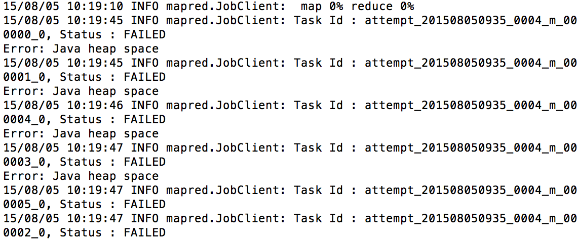
Limitations of MapReduce
Out-of-Memory Errors
High Memory Pressure
Inappropriate Configuration
There are many reasons for poor performance
And even experts sometimes can’t figure them out
Notes:
- 논문에 써있는 configuration parameter 수 체크
From now on, next contents are little a bit technical.
So don’t sleep.
Because many programming models which uses MR are generally implemented by managed languages like JAVA or C++
It uses garbage collector and sometimes it make problem

Slide 9
What is our goals?
Research Out-of-Memory Error cases
OOM cases documentation
Implement and simulate StackOverflow OOM cases
Develop solutions for such OOM cases
… all done!!
Notes:
I want to tell you what we are doing now

Slide 10
Two Categories
Inappropriate Configuration Configuration which causes poor performance
Large Intermediate Results Temporary data structure grows too large
[3] Lijie Xu, “An Empirical study on real-world OOM cases in MapReduce jobs, Chinese Academy of Sciences.
Notes:
We research some papers, and there’re some patterns which make an OOM. And we can categorize this patterns into 3 categories.

Slide 11
1. Inappropriate Configuration
Operation test environments
Standalone & Pseudo-distributed mode - ‘14 MacBook Pro, 2.8 GHz Intel Core i5 8GB 1600 MHz DDR3, 500GB HDD - ‘12 MacBook Air 1.4, GHz Intel Core i5 4GB 1600 MHz DDR3, 256GB HDD
Fully-distributed mode - Raspberry Pi 2 Model B (3 nodes) A quad-core ARM Cortex-A7 CPU (1Ghz Overclock) 1GB 500MHz SDRAM, 64GB HDD, 100Mbps Ethernet

Slide 12
Split size variation [Single node]
Input: StackOverflow’s users profiles (1GB)
(sec)
(sec)
(MB)
(MB)
[ Standard deviation of users’ age ]
[ Distributed grep (no Reducer) ]
Standalone
Pseudo-distributed
(2Mapper 2Reducer)
Pseudo-distributed
(4Mapper 4Reducer)
* ‘14 MacBook Pro 2.8, GHz Intel Core i5, 8GB 1600 MHz DDR3, 500GB SSD
Notes:
Show just running time decrease

Slide 13
Split size variation [Single node]
Input: StackOverflow’s Comments (8.5GB)
(sec)
(sec)
(MB)
(MB)
[ ]
[ ]
Standard deviation of
comment’s text length
Count Min
and Max value
Standalone
Pseudo-distributed
(2Mapper 2Reducer)
Pseudo-distributed
(4Mapper 4Reducer)
* ‘12 MacBook Air 1.4, GHz Intel Core i5, 4GB 1600 MHz DDR3, 256GB SSD
Notes:
Show just running time decrease

Slide 14


Split size variation [Fully-distributed]
Input: StackOverflow’s users profiles (1GB)
(sec)
(sec)
(MB)
(MB)
[ average users’ age based on countries ]
[ Distributed grep (no Reducer) ]
6 Mapper
12 Mapper
* Raspberry Pi 2 Model B (3 nodes) A quad-core ARM Cortex-A7 CPU (1Ghz Overclock) 1GB 500MHz SDRAM, 64GB HDD, 100Mbps Ethernet
800MHz (6M6R) | 32MB | 64MB | 128MB | 256MB
1st | 8m28s | 8m32s | 10m0s | 12m46s
2nd | 8m35s | 8m44s | 9m58s | 12m14s
3rd | 8m33s | 8m59s | 10m13s | 13m38s
Avg. | 8m32s | 8m45s | 10m4s | 12m53s
[master]
[worker1]
100Mbps
Ethernet
[worker2]
Notes:
Why graph grows?
Because 256 split size has just 4 map tasks
It means 2 of 6 mapper will not work.
So we need more bigger

Slide 15
io.sort.mb variation [Single node]
Input: StackOverflow’s Comments (8.5GB)
Test program: Standard deviation of comment’s text length
(sec)
(MB)
* ‘12 MacBook Air 1.4, GHz Intel Core i5, 4GB 1600 MHz DDR3, 256GB SSD
Notes:
Factor value 가 io.sort.mb의 1/10임을 말로 설명
Show just running time decrease

Slide 16
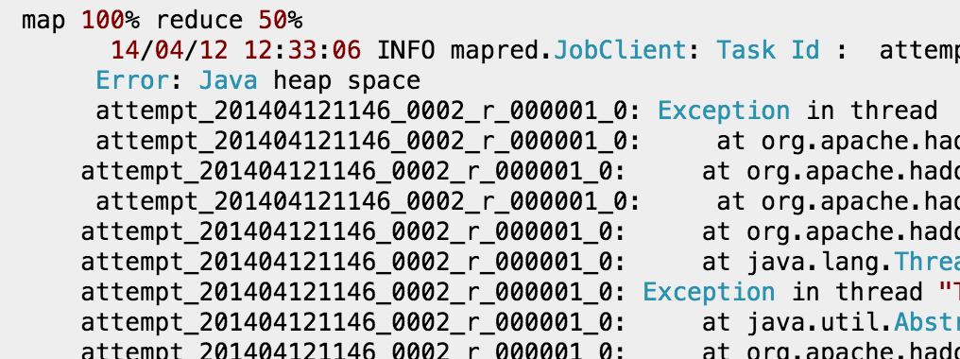
2. Large Intermediate Results
I am working well with small datasets like 200-500MB. But for datasets above 1GB, I am getting an error like this:
* http://stackoverflow.com/questions/23042829/getting-java-heap-space-error-while-running-a-mapreduce-code-for-large-dataset

Slide 17
Problem Investigation
The Mapper
Task 1
[K, V]
Task 2
1.3
GB
[K, V]
Task 3
Task 4
[K, V]
4.8
GB
Task 5
Intermediate
Key/value pairs
[K, V]
JAVA HEAP SPACE
Splited
Input files
almost
1 GB
[K, V]

Slide 18
Problem Investigation
The Reducer
[K, V]
I just have
1GB Heap
Space!
[K, V]
[K, V]
4.8
GB
Intermediate
Key/value pairs
[K, V]
JAVA HEAP SPACE
almost
1 GB
[K, V]
almost
1 GB
Java heap can’t contain
Intermediate data structure

Slide 19
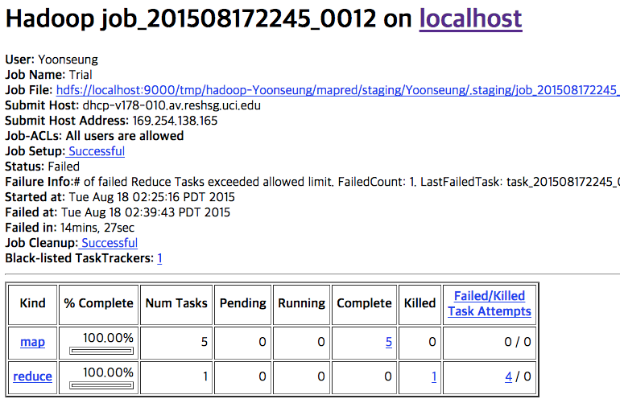
Configuration was:
1.3GB Input, 256MB Split size, 1024MB Java Heap Space
Error: Java heap space

Slide 20
Summary of Solution
Modify the Configuration parameters
Alter the program’s algorithm : Some alternative solution was suggested from the site -> Succeed with original version failed Configuration ( 256MB Split size & 1024MB Java heap size )
Java Heap size |  | 1024MB | 2048MB
Split size | 128 MB | Succeed | Succeed
 | 256 MB | Failed | Succeed

Slide 21
Conclusion
How to solve the poor performance
1. Adjust ‘split size’ - the more ‘split size’, the less time to spend
2. Adjust ‘map task capacity’ - suitable for input file size - Big size of map task capacity is not always right
If intermediate data structure is too large, - Modify the configuration parameter or - Alter the program’s algorithm

Slide 22
References
[1] Jeffrey Dean and Sanjay Ghemawat. (2004). “MapReduce: Simplified Data Processing on Large Clusters”. [Online]. Available: http://static.googleusercontent.com/media/research.google.com/ko//archive/mapreduce-osdi04.pdf
[2] 한기용, Do it! 직접 해보는 하둡 프로그래밍. Seoul: EasysPublishing, 2013.
[3] Lijie Xu, “An Empirical study on real-world OOM cases in MapReduce jobs, Chinese Academy of Sciences.
[4] Donald Miner and Adam Shook, MapReduce Design Patterns. O’Reilly Media. Inc, 2012.

Slide 23
Thank You
And if you want to know more technical information, please enter our GitHub repository.
https://github.com/I-SURF-Hadoop/MapReduce

Slide 24
appendix
How does MapReduce really work?

Slide 25
How does MapReduce work?
The cat sees the dog, and the dog sees the cat.
The cat sees the dog
the, 1
Combining & Sorting
[ Map Phase ]
cat, 1
cat, 1
MapReduce library first splits the input into M pieces.
A map worker processes these pieces using a user-defined Map function. Intermediate key/value pairs will be produced by this function.
sees, 1
dog, 1
the, 1
sees, 1
dog, 1
the, 2

Slide 26
How does MapReduce work?
The cat sees the dog, and the dog sees the cat.
cat, 1
Shuffling
[ Reduce Phase ]
dog, 1
and, 1
sees, 1
When a reduce worker has read all intermediate data, it sorts them by the intermediate keys.
The reduce worker iterates the sorted intermediate data and for each unique intermediate key encountered, it passes the key and the values to the user’s Reduce function.
cat, 2
the, 2
dog, 2
and, 1
sees, 2
cat, 1
the, 4
dog, 1
sees, 1
the, 2
Two independent reducer

